Slide 1



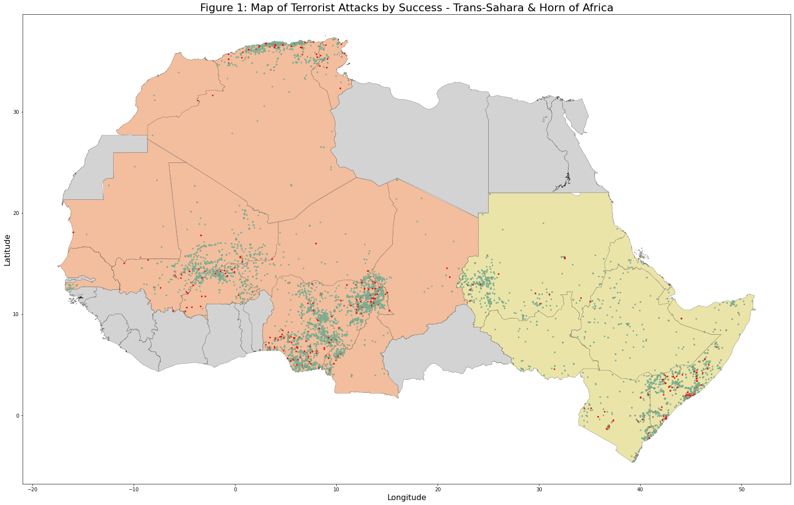
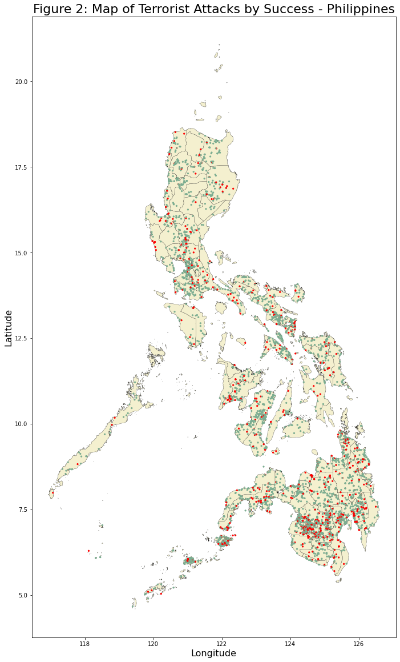
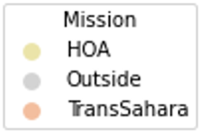
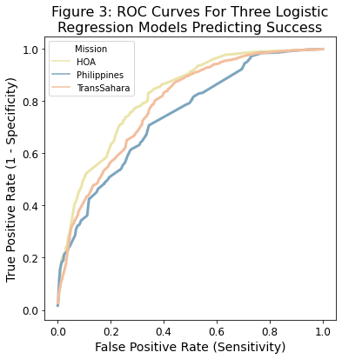
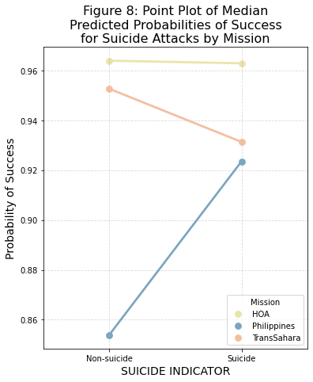
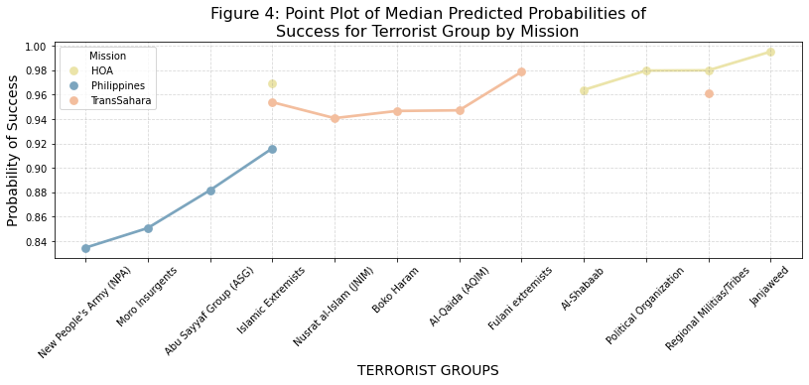
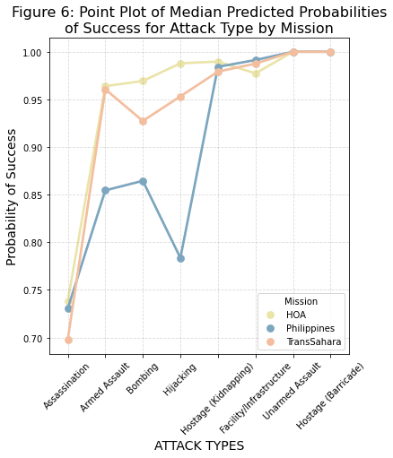
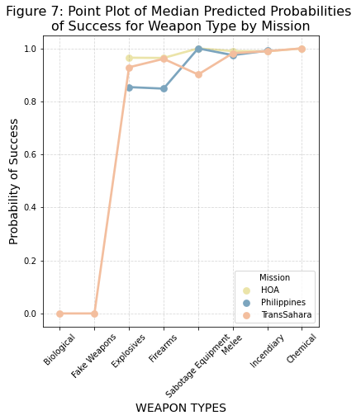
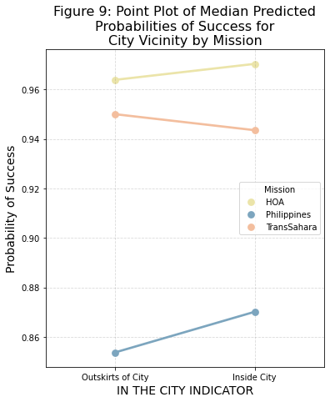
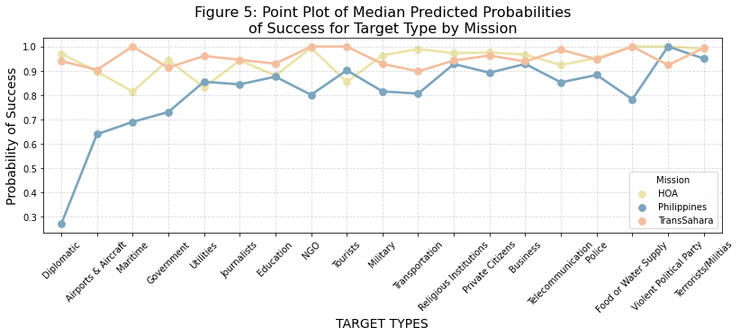
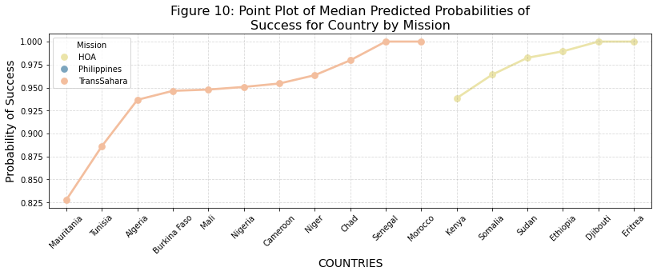





OPERATION ENDURING FREEDOM: Improving Mission Effectiveness
by Identifying Trends in Successful Terrorism
Dalton Shaver – Graduating May 2023
ABSTRACT
Professor Susan Hardy, Dr. Gene Ray, Dr. Austin Brown
RESULTS
This research examines how the characteristics of terrorist attacks predict the chance of an attack succeeding, where an attack is defined as successful if the intended attack type is carried out. Data from The Global Terrorism Database was analyzed across three geographical missions within Operation Enduring Freedom: Trans-Sahara, Horn of Africa, and the Philippines. The three models were able to distinguish between successful and unsuccessful attacks at 78.74%, 82.11%, 74.25%, respectively. Using predicted probabilities of success obtained from each logistic regression model, the medians were plotted to compare the characteristics of terrorist attacks across missions. The coefficients for each model were analyzed to compare the odds of success for each variable level to the odds of success of the reference level for that variable. Lastly, the coordinates for successful and unsuccessful attacks as classified by the dataset was plotted to explore spatial patterns in regional maps. Many insights were gathered through analyzing Operation Enduring Freedom missions. By determining the specific characteristics of attacks that produce the highest probabilities of success, the effectiveness of Operation Enduring Freedom can be improved by focusing counter-terrorism training and operations on the features that predict successful attacks.
Algiers
Success Indicator
Unsuccessful Successful
MAPPING OF SUCCESSFUL/UNSUCCESSFUL ATTACKS Figure 1 shows that terrorist attacks are concentrated in Algeria, Mali, Burkina Faso, Nigeria, Sudan, and Somalia. Figure 2 shows that terrorist attacks have historically occurred throughout all provinces in the Philippines. Failed attempts are most frequent on the southern island of Mindanao. Failed attempts are sporadic within the clusters of successful attacks.
HIGH ODDS RATIOS OF SUCCESSFUL ATTACKS Figure 3 shows the stratified ROC Curves for the three logistic regression models. The chances that each model can distinguish between successful and unsuccessful attacks for each of the three operations are: Trans-Sahara (78.74%), Horn of Africa (82.11%), Philippines (74.25%). Table 1, 2, and 3 show the exponentiated coefficients which result in the odds ratios of each level compared to the reference level. The reference level is given under each group of variable levels.
MEDIAN PREDICTED PROBABILITIES OF SUCCESS
GROUP Figure 4 shows that attacks carried out by the New People’s Army is predicted to have the lowest probability of success compared to any other terrorist group. Fulani extremists in the Trans-Sahara and Janjaweed in the Horn of Africa, both regional ethnic groups, are predicted to be more successful than jihadist terrorist groups (Nusrat al-Islam, Boko Haram, Al-Qaida, Al-Shabaab).
TARGET TYPE Figure 5 shows the predicted probability of success for attack targets.
Attacks targeting diplomatic and government personnel, airports, and maritime facilities have a lower probability of success in the Philippines.
Attacks targeting private citizens, tourists, non-governmental organizations, maritime facilities, and food or water supply, have the largest probability of success for attacks in the Trans-Sahara and Horn of Africa.
ATTACK TYPE Figure 6 displays similarities in the effect that attack methods have on the probability of success in all three mission areas.
Unarmed Assaults, Infrastructure Attacks, Kidnappings, and Barricade Incidents have probabilities of success greater than 0.95 for each of the three mission areas.
Bombings, Hijackings, and Armed Assaults in the Philippines have a lower probability of success compared to the Trans-Sahara and Horn of Africa regions.
WEAPON TYPE Figure 7 shows that the predicted probability of success when explosives and firearms are used is lower in the Philippines than the Trans-Sahara and Horn of Africa. Biological and Fake weapons are predicted to result in a failed terrorist attack in the Trans-Sahara.
SUICIDE Figure 8 shows that suicide attacks increase the probability of success in the Philippines. However, they decrease the probability of success in the Trans-Sahara. The involvement of suicide in attacks in the Horn of Africa have little effect on the probability of an attack succeeding.
VICINITY Figure 9 shows that an attack will have a similar probability of success,
regardless of whether an attack takes place inside the city or on the outskirts of the city in any of the three mission areas.
COUNTRY Figure 10 shows the predicted probability of successful terrorist attacks.
Trans-Sahara Attacks in Mauritania are predicted to have the lowest probability of succeeding while attacks in Morocco and Senegal have the highest probability of succeeding.
Horn of Africa Attacks in Kenya are predicted to have the lowest probability of succeeding while attacks in Djibouti and Eritrea have the highest probability of succeeding.
Philippines Operation Enduring Freedom – Philippines is concentrated in only the Philippines.
Morocco
Tunisia
Algeria
Mauritania
Mali
Niger
Eritrea
Manila
Senegal
Burkina Faso
Chad
Al Fashir
Sudan
Djibouti
Nigeria
Maiduguri
Ethiopia
Somalia
INTRODUCTION
Cameroon
Kenya
Mogadishu
Operation Enduring Freedom is a comprehensive response to the spread of terrorism around the world. Beginning in 2002, the United States spearheaded counter-terrorism efforts towards training, equipping, and conducting combat operations in the hopes of strengthening regional security and peace. Regions in which specific counter-terrorism missions have been established are continuing to endure insurgency resistance and violent extremism. Contrary to international terrorism, many countries are currently battling terrorists and militants in open confrontation over sovereign territory and resources. Terrorist groups have seized governing authority in numerous areas under their control, imposing taxes and restrictions on the general populace. As extremist conflict continues in highly affected regions such as West Africa, East Africa, and Southeast Asia, intelligence-driven counter-terrorism strategies are crucial to increasing mission effectiveness and establishing long-term security.
Success Indicator
Unsuccessful Successful
Davao City
Table 1: Odds for Successful Attacks in the Trans-Sahara
Table 2: Odds for Successful Attacks in the Horn of Africa
Mindanao
Parameter | Βeta | Pr > |t| | Odds
Intercept | 2.670 | 0.0001 | 14.44
suicide | 0.041 | 0.7965 | 1.04
vicinity | 0.043 | 0.7536 | 1.04
gname Al-Qaida (AQIM) | 0.004 | 0.9885 | 1.00
gname Boko Haram | 0.102 | 0.6153 | 1.11
gname Fulani extremists | 0.735 | 0.0067 | 2.09
gname Nusrat al-Islam (JNIM) | -0.146 | 0.6686 | 0.86
gname Regional Militias/Tribes | 0.016 | 0.9561 | 1.02
gname Reference --- Islamic Extremists
attacktype1 Armed Assault | 0.289 | 0.2118 | 1.33
attacktype1 Assassination | -1.607 | 0.0001 | 0.20
attacktype1 Facility/Infrastructure | 1.391 | 0.0124 | 4.02
attacktype1 Hijacking | 0.036 | 0.9629 | 1.04
attacktype1 Hostage (Barricade) | 9.161 | 0.8540 | 9519.52
attacktype1 Hostage (Kidnapping) | 0.984 | 0.0008 | 2.68
attacktype1 Unarmed Assault | 8.722 | 0.9334 | 6135.83
attacktype1 Reference --- Bombing
targtype1 Airports & Aircraft | -0.958 | 0.3680 | 0.38
targtype1 Business | -0.470 | 0.0287 | 0.63
targtype1 Education | -1.139 | 0.0001 | 0.32
targtype1 Food or Water Supply | 8.467 | 0.9642 | 4756.66
targtype1 Diplomatic | -0.346 | 0.2819 | 0.71
targtype1 Government | -0.743 | 0.0001 | 0.48
targtype1 Journalists | -0.348 | 0.4774 | 0.71
targtype1 Maritime | 8.731 | 0.9019 | 6193.77
targtype1 Military | -0.492 | 0.0001 | 0.61
targtype1 NGO | 8.368 | 0.8824 | 4307.01
targtype1 Police | -0.171 | 0.3031 | 0.84
targtype1 Religious Institutions | -0.319 | 0.1680 | 0.73
targtype1 Telecommunication | -0.772 | 0.3113 | 0.46
targtype1 Terrorists/Militias | 2.031 | 0.0451 | 7.62
targtype1 Tourists | 7.928 | 0.9134 | 2772.76
targtype1 Transportation | -0.701 | 0.0200 | 0.50
targtype1 Utilities | 0.524 | 0.2307 | 1.69
targtype1 Violent Political Party | -0.240 | 0.5824 | 0.79
targtype1 Reference --- Private Citizens
weaptype1 Biological | -22.069 | 0.9558 | 0.00
weaptype1 Chemical | 8.618 | 0.9711 | 5531.97
weaptype1 Fake Weapons | -14.214 | 0.9705 | 0.00
weaptype1 Firearms | 0.134 | 0.5390 | 1.14
weaptype1 Incendiary | 0.921 | 0.1142 | 2.51
weaptype1 Melee | 0.637 | 0.1629 | 1.89
weaptype1 Sabotage Equipment | -2.010 | 0.1022 | 0.13
weaptype1 Reference --- Explosives
country Algeria | 0.385 | 0.0356 | 1.47
country Burkina Faso | 0.311 | 0.1599 | 1.36
country Cameroon | 0.266 | 0.0872 | 1.31
country Chad | 1.139 | 0.0307 | 3.12
country Mali | 0.533 | 0.0048 | 1.70
country Mauritania | -1.010 | 0.1717 | 0.36
country Morocco | 9.436 | 0.9231 | 12527.73
country Niger | 0.568 | 0.0875 | 1.76
country Senegal | 9.728 | 0.8652 | 16774.25
country Tunisia | -0.482 | 0.1085 | 0.62
country Reference --- Nigeria
Parameter | Beta | Pr > |t| | Odds
Intercept | 3.790 | 0.0001 | 44.27
suicide | -0.253 | 0.3335 | 0.78
vicinity | 0.021 | 0.9031 | 1.02
gname Al-Shabaab | -0.113 | 0.7717 | 0.89
gname Janjaweed | 0.635 | 0.4574 | 1.89
gname Political Organization | -0.965 | 0.1797 | 0.38
gname Regional Militias/Tribes | -0.031 | 0.9535 | 0.97
gname Reference --- Islamic Extremists
attacktype1 Armed Assault | -1.402 | 0.0001 | 0.25
attacktype1 Assassination | -3.365 | 0.0001 | 0.03
attacktype1 Facility/Infrastructure | -2.676 | 0.0001 | 0.07
attacktype1 Hijacking | -0.510 | 0.5208 | 0.60
attacktype1 Hostage (Barricade) | 9.040 | 0.9196 | 8431.25
attacktype1 Hostage (Kidnapping) | -0.375 | 0.3548 | 0.69
attacktype1 Unarmed Assault | 7.508 | 0.9371 | 1822.56
attacktype1 Reference --- Bombing
targtype1 Airports & Aircraft | -1.332 | 0.0033 | 0.26
targtype1 Business | -0.107 | 0.7194 | 0.90
targtype1 Education | -1.678 | 0.0001 | 0.19
targtype1 Food or Water Supply | 9.808 | 0.9410 | 18176.78
targtype1 Diplomatic | -0.092 | 0.8201 | 0.91
targtype1 Government | -0.422 | 0.0181 | 0.66
targtype1 Journalists | -0.455 | 0.1687 | 0.63
targtype1 Maritime | -2.003 | 0.0040 | 0.13
targtype1 Military | -0.170 | 0.3169 | 0.84
targtype1 NGO | 1.435 | 0.1607 | 4.20
targtype1 Police | -0.226 | 0.2946 | 0.80
targtype1 Religious Institutions | 0.119 | 0.7905 | 1.13
targtype1 Telecommunication | -0.149 | 0.8044 | 0.86
targtype1 Terrorists/Militias | 1.162 | 0.1243 | 3.20
targtype1 Tourists | -1.985 | 0.0865 | 0.14
targtype1 Transportation | 1.069 | 0.2943 | 2.91
targtype1 Utilities | -2.082 | 0.0035 | 0.12
targtype1 Violent Political Party | 8.832 | 0.9799 | 6846.55
targtype1 Reference --- Private Citizens
weaptype1 Chemical | -8.091 | 0.9901 | 0.00
weaptype1 Firearms | 1.179 | 0.0001 | 3.25
weaptype1 Incendiary | 3.173 | 0.0001 | 23.89
weaptype1 Melee | 1.282 | 0.0086 | 3.60
weaptype1 Sabotage Equipment | 12.428 | 0.9775 | 249646.20
weaptype1 Reference --- Explosives
country Djibouti | 9.399 | 0.9759 | 12072.68
country Eritrea | 10.770 | 0.9452 | 47576.77
country Ethiopia | 1.277 | 0.0182 | 3.59
country Kenya | -0.729 | 0.0001 | 0.48
country Sudan | 0.354 | 0.2000 | 1.42
country Reference --- Somalia
Table 3: Odds for Successful Attacks in the Philippines
Parameter | Beta | Pr > |t| | Odds
Intercept | 2.604 | 0.0001 | 13.52
suicide | 0.359 | 0.6790 | 1.43
vicinity | 0.050 | 0.7878 | 1.05
gname Abu Sayyaf Group (ASG) | -0.507 | 0.1572 | 0.60
gname Moro Insurgents | -0.497 | 0.1441 | 0.61
gname New People's Army (NPA) | -0.751 | 0.0242 | 0.47
gname Reference --- Islamic Extremists
attacktype1 Armed Assault | -0.863 | 0.0001 | 0.42
attacktype1 Assassination | -1.891 | 0.0001 | 0.15
attacktype1 Facility/Infrastructure | 0.080 | 0.8239 | 1.08
attacktype1 Hijacking | -0.702 | 0.2028 | 0.50
attacktype1 Hostage (Barricade) | 9.258 | 0.8623 | 10491.28
attacktype1 Hostage (Kidnapping) | 1.433 | 0.0007 | 4.19
attacktype1 Unarmed Assault | 7.443 | 0.9779 | 1707.18
attacktype1 Reference --- Bombing
targtype1 Airports & Aircraft | -1.562 | 0.0355 | 0.21
targtype1 Business | -0.215 | 0.2513 | 0.81
targtype1 Education | -0.178 | 0.5948 | 0.84
targtype1 Food or Water Supply | -0.826 | 0.3076 | 0.44
targtype1 Diplomatic | -3.228 | 0.0010 | 0.04
targtype1 Government | -0.088 | 0.5187 | 0.92
targtype1 Journalists | 0.605 | 0.0956 | 1.83
targtype1 Maritime | -1.488 | 0.0032 | 0.23
targtype1 Military | -0.367 | 0.0035 | 0.69
targtype1 NGO | -0.738 | 0.2707 | 0.48
targtype1 Police | 0.168 | 0.3325 | 1.18
targtype1 Religious Institutions | 0.445 | 0.3157 | 1.56
targtype1 Telecommunication | -0.378 | 0.3275 | 0.69
targtype1 Terrorists/Militias | 1.119 | 0.1362 | 3.06
targtype1 Tourists | -0.876 | 0.4417 | 0.42
targtype1 Transportation | -0.708 | 0.0105 | 0.49
targtype1 Utilities | -0.332 | 0.2925 | 0.72
targtype1 Violent Political Party | 9.789 | 0.9797 | 17838.24
targtype1 Reference --- Private Citizens
weaptype1 Firearms | 0.844 | 0.0001 | 2.32
weaptype1 Incendiary | 3.018 | 0.0001 | 20.45
weaptype1 Melee | 2.207 | 0.0349 | 9.08
weaptype1 Sabotage Equipment | 9.904 | 0.9709 | 20002.25
weaptype1 Reference --- Explosives
METHODS
AUC = 0.8211
Logistic Regression was used to predict whether a terrorist attack was either successful or unsuccessful based on characteristics of each attack.
Exponentiated Beta Coefficients were calculated to determine how each variable level affected the odds of a terrorist attack succeeding.
Stratified Point Plots display the median predicted probability of success for each predictor variable level.
Dot-Density Spatial Maps were used to visualize the geographical distribution of successful and unsuccessful terrorist attacks.
AUC = 0.7425
AUC = 0.7874
CONCLUSIONS
Operation Enduring Freedom can conserve resources, save lives, and prevent the spread of violent extremism by focusing on what makes a successful attack.
Barricade Incidents, Unarmed Assaults, Infrastructure Attacks, and Incendiary weapons have the highest probability of success. The odds of an attack succeeding when it involves a barricade incident with hostages is 10,491 times greater the odds of an attack succeeding when it involves bombings.
Attacks targeting private citizens, tourists, non-governmental organizations, and food or water supply, have the largest probability of success for the Trans-Sahara and Horn of Africa regions. Suicide attacks in the Philippines raise the chance of success.

